Slide 1

Application and optimization of a filtering approach for multiple object tracking in video data
Jing Huang
Betreuer:
Univ.-Prof. Dr.-Ing. Dirk Söffker
Mark Spiller, M.Sc.
27. November 2017
Lehrstuhl Steuerung, Regelung und Systemdynamik
Universität Duisburg-Essen

Slide 2
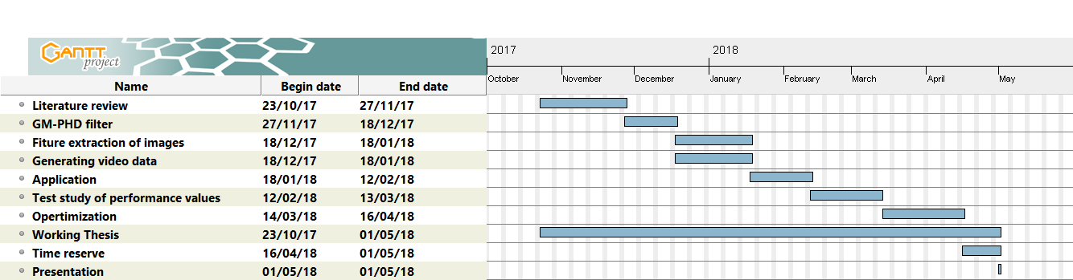
Granttplan

Slide 3
Introduction
Feature extraction of images
Generating video data
Application
Apply our GM-PHD filter on generated video
Test study of performance values
Different filter parameters and different scenarios influence performance value of GM-PHD filter
Optimization

Slide 4
Contents
Chapter 1 Introduction
Chapter 2 Single and multiple object tracking
2.1 Single and multiple object tracking
2.2 Kalman filter
2.3 Nearest neighbor filter (NNF)
2.4 PDA
Chapter 3 Gaussian mixture probability hypotheses density filter (GM-PHD)
3.1 Gaussian mixture distribution
3.2 GM-PHD Filter Tracker
Chapter 4 Application of GM-PHD Filter
4.1 processing of video data
4.2 Proposal of tracking algorithm
4.3 Evaluation
Chapter 5 Optimization of GM-PHD Filter
5.1 Introduction of performance values
5.2 result of difference scenarios
5.3 Influence of filter parameters
Chapter 6 Summary

Slide 5
Probability hypothese density Filter (PHD Filter)
Intensity function
Intergral gives numbers of expected objects
States of the moving objects can be extracted
Probability Hypothese Density filter (PHD)
Propagation of intensity function over time
No closed-form solution (just some numerical calculation)
GM-PHD Filter
Modeling of intensity function by gaussian mixtures
Closed-form solution exsists

Slide 6
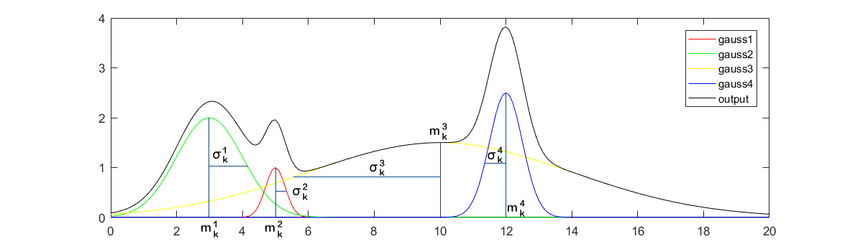

GM-PHD Filter Tracker
Intensity $D_{k|k}$ at Step k
output : the Intensity function generated by the sum of each weighted gaussian.

Slide 7
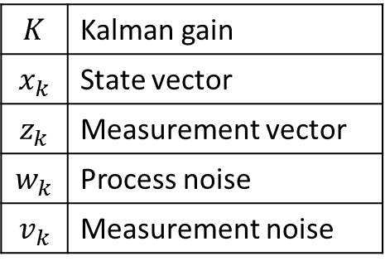
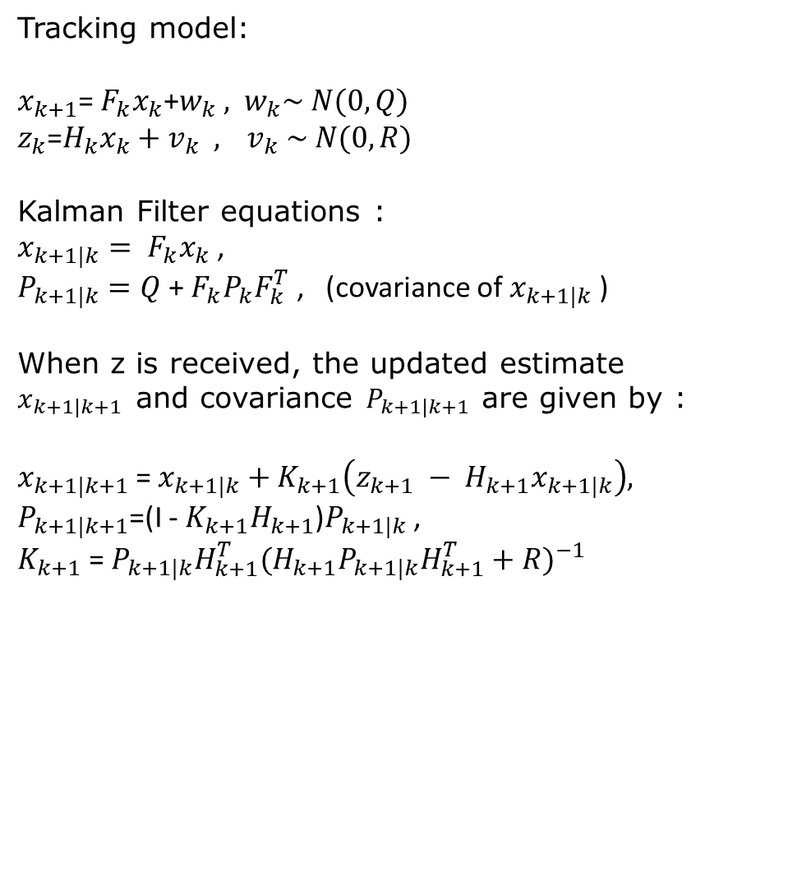
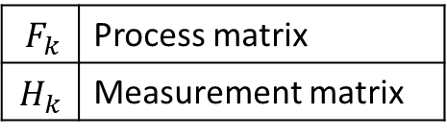
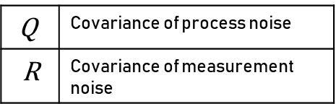
Kalman Filter
Tracking model:
$x_{k+1}$= $F_{k}x_{k}$+$w_{k} ,$ $w_{k}\sim N(0,Q)$
$z_{k}$=$H_{k}x_{k}+v_{k} ,$ $v_{k} \sim N(0, R)$
Kalman Filter equations :
$x_{k+1|k}= F_{k}x_{k}$ ,
$P_{k+1|k}=Q$+ $F_{k}P_{k}F_{k}^{T}$ , (covariance of $x_{k+1|k}$ )
When z is received, the updated estimate $x_{k+1|k+1}$and covariance $P_{k+1|k+1}$ are given by :
$x_{k+1|k+1}$= $x_{k+1|k}+K_{k+1}\left(z_{k+1} − H_{k+1}x_{k+1|k}\right),$
$P_{k+1|k+1}$=(I - $K_{k+1}H_{k+1}$)$P_{k+1|k}$ ,
$K_{k+1}$ = $P_{k+1|k}H_{k+1}^{T}(H_{k+1}P_{k+1|k}H_{k+1}^{T}+R)^{−1 }$
$F_{k}$ | Process matrix
$$H_{k}$$ | Measurement matrix
$$K$$ | Kalman gain
$$x_{k}$$ | State vector
$$z_{k}$$ | Measurement vector
$$w_{k}$$ | Process noise
$$v_{k}$$ | Measurement noise
Q | Covariance of process noise
$$\text{R}$$ | Covariance of measurement noise

Slide 8
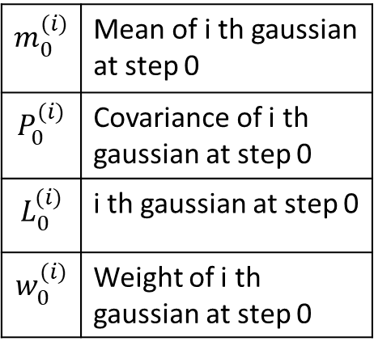
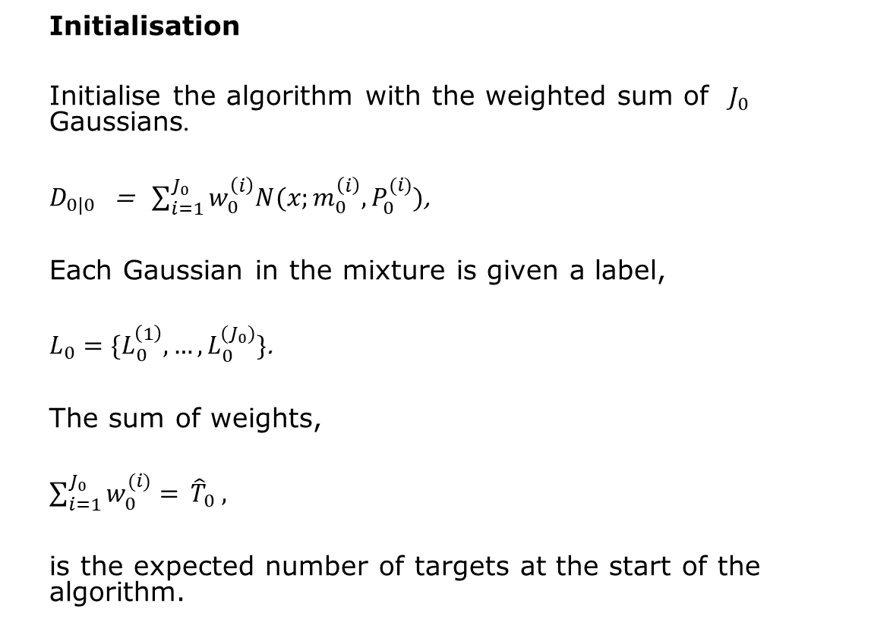
Algorithm of GM-PHD Filter I
Initialisation
Initialise the algorithm with the weighted sum of $J_{0}$ Gaussians.
$D_{0|0}$ = $\sum_{i=1}^{J_{0}}{w_{0}^{\left(i\right)}N(x;m_{0}^{\left(i\right)},P_{0}^{(i)})}$,
Each Gaussian in the mixture is given a label,
$L_{0}=\{L_{0}^{\left(1\right)},…,L_{0}^{(J_{0})}\}$.
The sum of weights,
$\sum_{i=1}^{J_{0}}{w_{0}^{(i)}= }{\hat{T}}_{0}$ ,
is the expected number of targets at the start of the algorithm.
$$m_{0}^{(i)}$$ | Mean of i th gaussian at step 0
$$P_{0}^{(i)}$$ | Covariance of i th gaussian at step 0
$$L_{0}^{(i)}$$ | i th gaussian at step 0
$$w_{0}^{(i)}$$ | Weight of i th gaussian at step 0

Slide 9
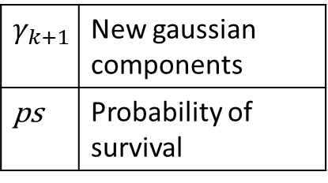
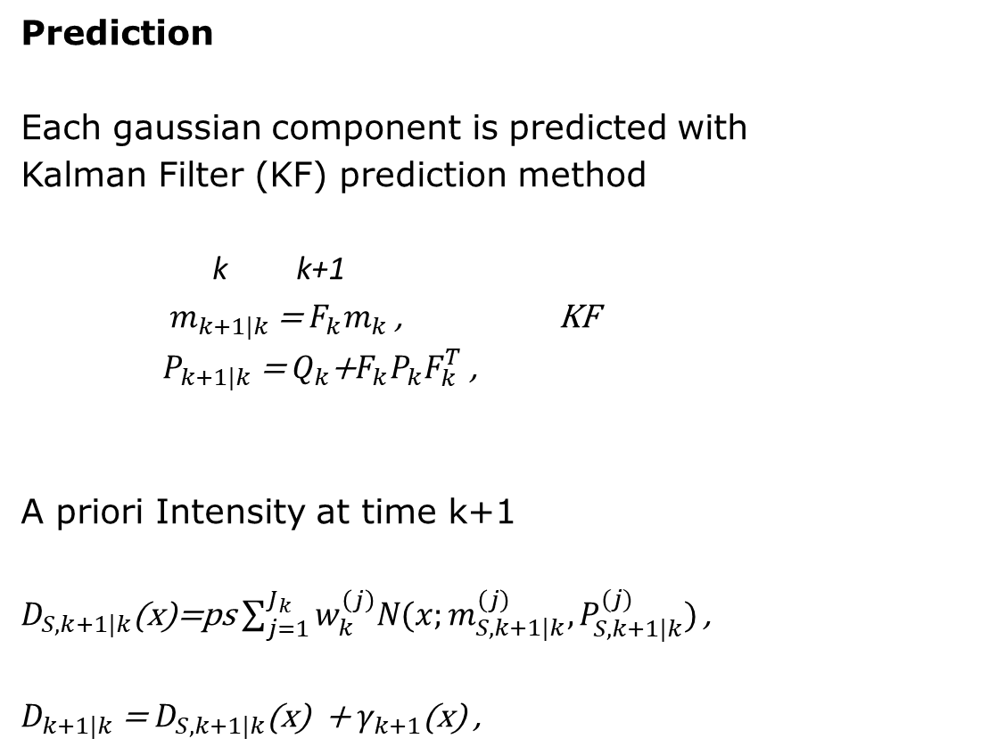
Algorithm of GM-PHD Filter II
Prediction
Each gaussian component is predicted with
Kalman Filter (KF) prediction method
k k+1
$m_{k+1|k}$ = $F_{k}m_{k}$ , KF
$P_{k+1|k}$ = $Q_{k}$+$F_{k}P_{k}F_{k}^{T}$ ,
A priori Intensity at time k+1
$D_{S,k+1|k}$(x)=ps $\sum_{j=1}^{J_{k}}{w_{k}^{\left(j\right)}N(x;m_{S,k+1|k}^{\left(j\right)}, P_{S,k+1|k}^{(j)})}$ ,
$D_{k+1|k}$ = $D_{S,k+1|k}$(x) + $γ_{k+1}$(x) ,
$$γ_{k+1}$$ | New gaussian components
ps | Probability of survival

Slide 10

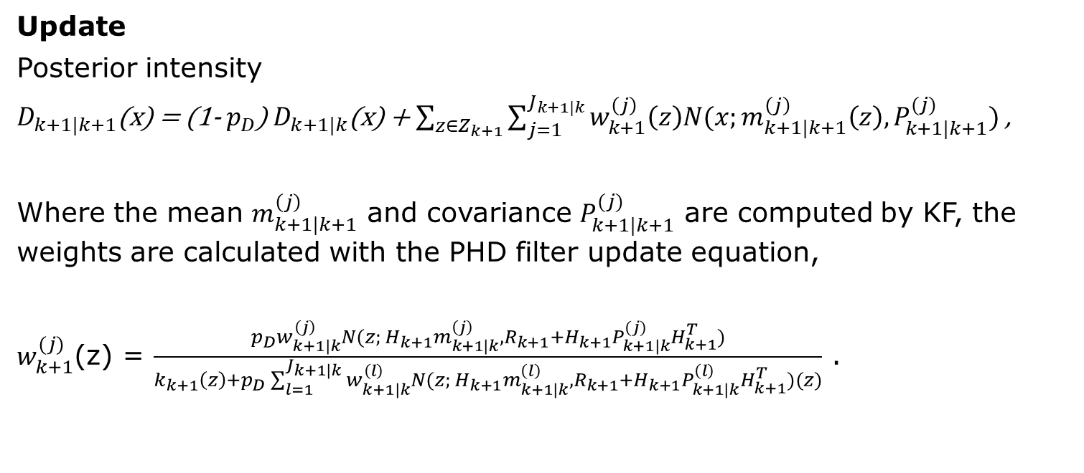
Algorithm for GM-PHD III
Update
Posterior intensity
$D_{k+1|k+1}$(x) = (1- $p_{D}$) $D_{k+1|k}$(x) + $\sum_{z∈Z_{k+1}}{\sum_{j=1}^{J_{k+1|k}}{w_{k+1}^{\left(j\right)}\left(z\right)N(x;m_{k+1|k+1}^{\left(j\right)}\left(z\right), P_{k+1|k+1}^{(j)}) }}$,
Where the mean $m_{k+1|k+1}^{\left(j\right)}$ and covariance $P_{k+1|k+1}^{(j)}$ are computed by KF, the weights are calculated with the PHD filter update equation,
$w_{k+1}^{(j)}$(z) = $\frac{p_{D}w_{k+1|k}^{\left(j\right)}N(z; H_{k+1}m_{k+1|k}^{\left(j\right)}, R_{k+1}+H_{k+1}P_{k+1|k}^{(j)}H_{k+1}^{T})}{k_{k+1}\left(z\right)+p_{D}\sum_{l=1}^{J_{k+1|k}}{w_{k+1|k}^{\left(l\right)}}N(z; H_{k+1}m_{k+1|k}^{\left(l\right)}, R_{k+1}+H_{k+1}P_{k+1|k}^{\left(l\right)}H_{k+1}^{T})(z)}$ .
$p_{D}$ | Probability of detection

Slide 11
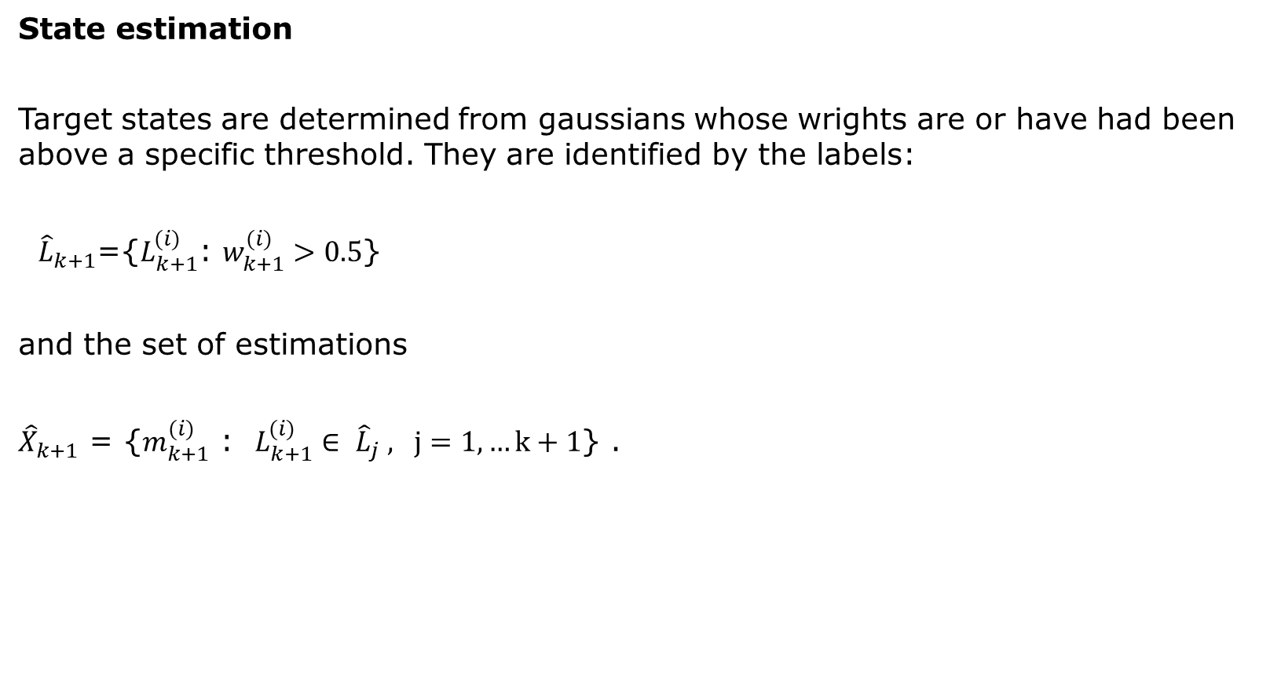
Algorithm for GM-PHD IV
State estimation
Target states are determined from gaussians whose wrights are or have had been above a specific threshold. They are identified by the labels:
${\hat{L}}_{k+1}$={$L_{k+1}^{(i)}$: $w_{k+1}^{(i)}>0.5$}
and the set of estimations
${\hat{X}}_{k+1}$ = {$m_{k+1}^{(i)}$ : $L_{k+1}^{(i)}∈ {\hat{L}}_{j} , j=1, …k+1$} .

Slide 12
Outlook
Generate sonar video in matlab

Slide 13
Thanks for your attention

